Slide 1
Azure iot hub
Raffaele Aldrigo | Backend developer

Slide 2
Meeting agenda
Introduction
Iot on Azure
Azure Iot Hub overview
Coffè break & team building
Hands-on part 1
Hands-on part 2
Q&A

Slide 3
Labcamp objectives
What you’ll learn
In this labcamp you will build a c# application that will use Azure Iot,
In particular:
Read messages sent from devices to the cloud (d2c messages)
Send messages to devices (c2d messages)
Read devices reported properties using device twin
Call methods on devices (direct methods)
Notes:
Cos’è Iot?

Slide 4

NEW GENERATION TELEMATICS IN CNHI
This project is developed in cooperation with Microsoft that provides strategic vision and governance while Reply collaborates on solution design and is responsible for development and test of solution.
As a result, more than 5000 worldwide connected vehicles will be using this platform in the following 3 years.

Slide 5
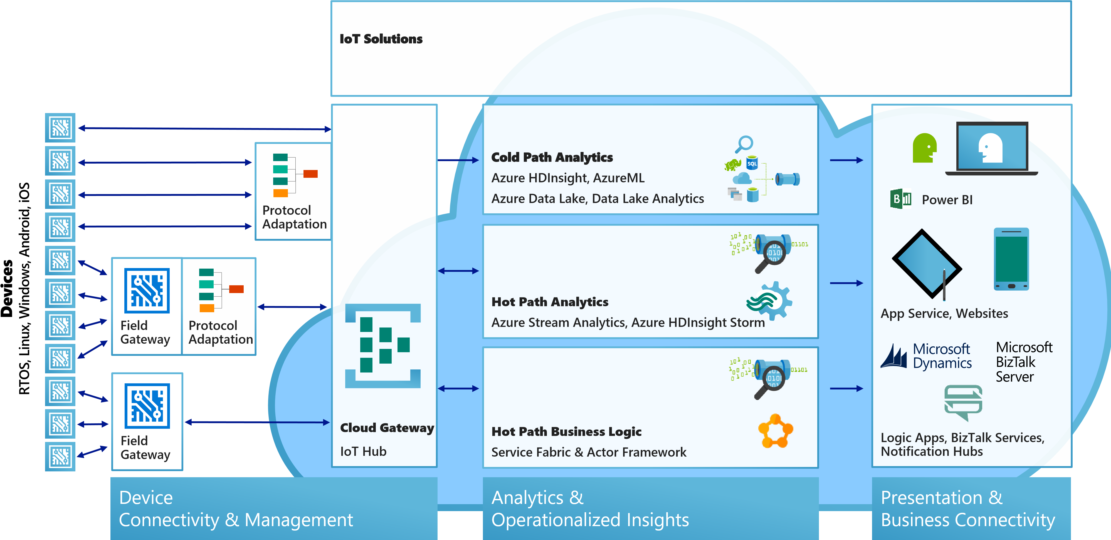
Iot on azure

Slide 6


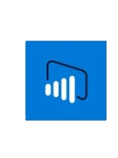

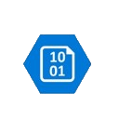
Azure services for iot
Azure Iot Hub
Connect, secure, communicate, monitor and manage billions of devices
Azure App Service
Web and mobile apps for any platform on any device
Azure Stream Analytics
Real time stream processing for billions of Iot Devices
Power BI
Dashboards and data connectors to visualize any data
Azure Storage
Blob, SQL, DocumentDB, Data Lake. Storage to meet every need at the scale of IoT
And more...

Slide 7
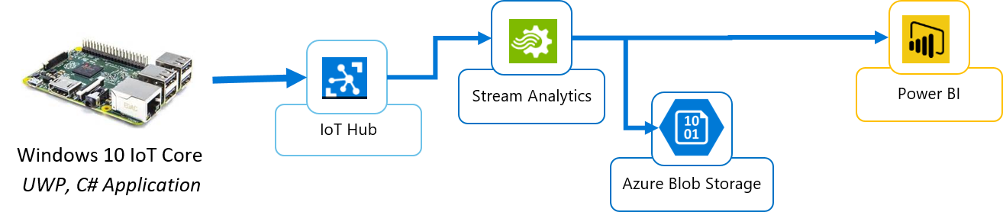
Sample iot app
Get sensor data from device
Send data to the «cloud» -> Azure Iot Hub
Extract data from Azure IoT Hub from d2c queue
Store (Blob storage) and Analyze data (Power BI)

Slide 8
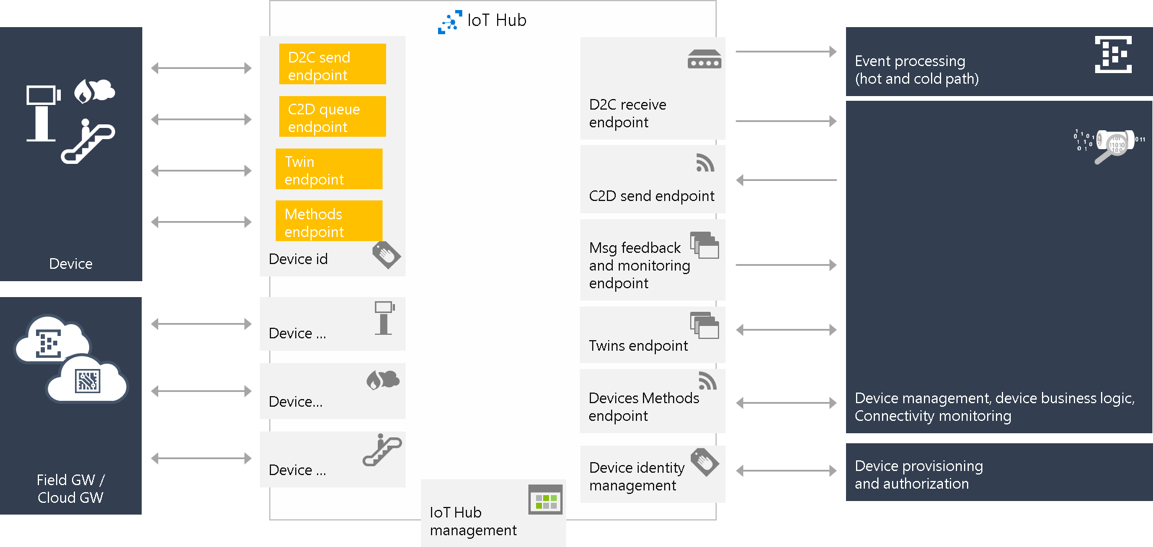
Iot hub endpoints
Notes:
Partire dall’identity, twin, device methods e poi d2c e c2d

Slide 9
Queue
Service bus
Dead letter
Queue
Complete / abbandon
message
message
A completed message is removed from the queue.
Only for Azure Event Hub (d2c)
If many applications need to read a same message, then we can define
consumer groups:
when all consumers complete the message then it is deleted.
Notes:
Dire che la coda ha una certa capienza e che i messaggi hanno una scadenza (tutto configurabile)
«Per l’hands-on vi verrà dato un consumer group, ovvero TeamXX»

Slide 10
Device application
To access Iot Hub functions we need a key. On the IoT Hub we can define various policies, and we will have one key for each policy.
How to: https://goo.gl/Uz3HEb
deviceClient = DeviceClient.Create(iotHubUri, new DeviceAuthenticationWithRegistrySymmetricKey(deviceId, deviceKey), TransportType.Mqtt);
//update twin
var twin = await deviceClient.GetTwinAsync();
var reportedProperties = new TwinCollection();
reportedProperties["key"] = ...;
await deviceClient.UpdateReportedPropertiesAsync(reportedProperties);
await deviceClient.SetMethodHandlerAsync("deviceMethod", DeviceMethod, null);
Task.WaitAll( SendDeviceToCloudMessagesAsync(), ReceiveC2dAsync() );

Slide 11
private static async Task SendDeviceToCloudMessagesAsync(CancellationToken ct) {
while (!ct.IsCancellationRequested) {
var telemetryDataPoint = ...
var message = new Message(Encoding.ASCII.GetBytes(JsonConvert.SerializeObject(telemetryDataPoint)));
await deviceClient.SendEventAsync(message);
await Task.Delay(3000);
}
}
private static async Task ReceiveC2dAsync(CancellationToken ct) {
while (!ct.IsCancellationRequested) {
Message receivedMessage = await deviceClient.ReceiveAsync();
if (receivedMessage == null) continue;
string content = Encoding.ASCII.GetString(receivedMessage.GetBytes());
...
await deviceClient.CompleteAsync(receivedMessage);
}
}
public static Task<MethodResponse> DeviceMethod(MethodRequest methodRequest, object userContext){
...
}

Slide 12
Break & Team building

Slide 13
Hands-on checklist
Visual Studio (or Visual Studio Code) with C# console application
Let’s subdivide in teams (max 20)
Download common library: https://goo.gl/oHTLcv
Create a new c# solution with a console app and reference IotLab.Common
Install NuGet Microsoft.Azure.Devices

Slide 14

On your marks
Get set
Code!

Slide 15
device 2 cloud messages
https://goo.gl/4QsYpF
eventHubClient = EventHubClient.CreateFromConnectionString(Config.IotHub.ConnectionStringService, "messages/events");
var partitions = eventHubClient.GetRuntimeInformation().PartitionIds;
foreach (string partition in partitions) {
ReceiveMessagesFromDeviceAsync(partition, cts.Token));
}
private static async Task ReceiveMessagesFromDeviceAsync(string partition) {
var eventHubReceiver = eventHubClient.GetConsumerGroup("teamXX").CreateReceiver(partition, DateTime.UtcNow);
while (true) {
EventData eventData = await eventHubReceiver.ReceiveAsync();
...
}
}

Slide 16
2) Send Cloud 2 Device messages
Guide: https://goo.gl/eucTrp
3) Read device twin reported properties
Guide: https://goo.gl/rqjLTv
4) Invoke direct method
var methodInvocation = new CloudToDeviceMethod(…);
methodInvocation.SetPayloadJson(…);
serviceClient.InvokeDeviceMethodAsync(…);

Slide 17
Q&A

Slide 18

THANKS Giuseppe Catonio
Mirko Rubaldo
Valentina Valle

